Slide 1

Statistical view of the learning process
Huafu Chen
SLST
UESTC, 2006-

Slide 2
2.13 Statistical nature of the learning process
Focus on: the deviation between a “target” function f(x) and the “actual” function F(x,w) realized by the neural network.
  The deviation is expressed in statistical terms.
A neural network is merely one form in which empirical knowledge about a physical phenomenon or environment of interest may be encoded through training.
  empirical knowledge ：a set of measurements that characterizes the phenomenon.

Slide 3
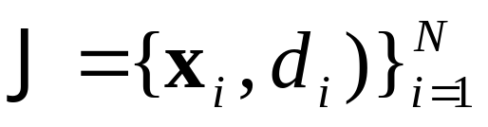
Example：
Stochastic phenomenon described by a random vector X ( independent variables) , and a random scalar D ( dependent variables ).
Suppose we also have N realizations of X denoted by {x_{i}}^{N} _{i=1} and a corresponding set of realization of D denoted by {d_{i}} ^{N} _{i=1}.
This realization constitute the training sample denoted by:

Slide 4
Example：
Ordinarily we do not have knowledge of the exact functional relationship between X and D, so we proceed by proposing the model: (Regressive model)
D=f(X)+ε （2.54）
where f(·) is a deterministic function of its argument vector, and ε is a random expectational error that represents our “ignorance” about the dependence of D and X.

Slide 5
Two useful properties：
  1） E(ε|x)=0 ; → f(x)=E[D|x] （2.56）
  2） E[εf(X)]=0 ; （2.57）
  (principle of orthogonality)
Notes:
（2.57) 期望误差与回归函数是不相关的
Figure 2-20 (a) Regressive model (mathematical). (b) Neural network model (physical).

Slide 6
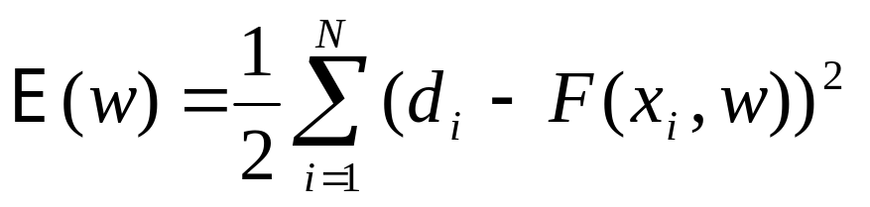
The neural network (approximation to the regressive model) →encode the empirical knowledge represented by the training sample J into a corresponding set of synaptic weight vector w，as shown by
J → W （2.58）
Let actual response to X be denoted by the random variable Y
Y=F(X,w) （2.59）
w is obtained by minimizing the cost function:
（2.60）
Notes:
——the use of “batch” training means that the adjustments to the synaptic weights of the network are performed over the entire set of training examples rather than on an example-by-example basis.

Slide 7
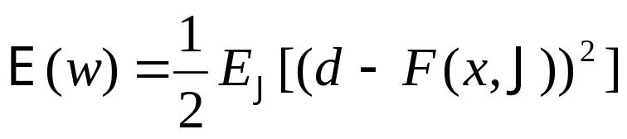
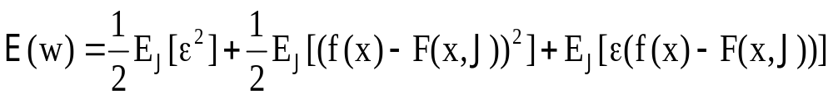
In light of （2.58）(J → W), we may rewrite（2.60）as
（2.61）
By adding and subtracting f(x) to the argument（d-F(x,J)）and using (2.61) and (2.54) (D=f(X)+ε) and then expanding terms, we may recast E(w) in the equivalent form (loss function)：
（2.62）
The particular value of the weight vector w* that minimizes the cost function E(w) will also minimize the ensemble average of the squared distance between the regression function f(x) and the approximating function F(x,w).
Notes:
The first term is a constant /independent to the NN, The last term of (2.62) is zero because 1) 2.57; 2) F(x,J) is belongs to NN model, error is belongs to measurement system, thus they are incorrelated

Slide 8
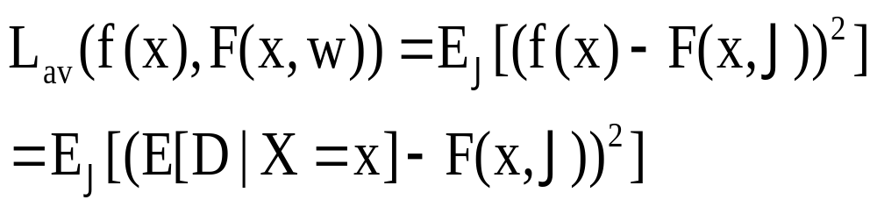
The natural measure of the effectiveness of F(x,w) as a predictor of the desired response d is defined by：
（2.64）
(2.65)
Notes:
从（2。65） 到 （2。66） （2。67）中省略了 展开的交叉项 （交叉项 来源于不同 的来源，不相干）
By added and subtracted the average EJ[(F(x,J)], we ge the following equations

Slide 9



（2.66）
where： （2.67）
（2.68）
B(w)：the bias of the average value of the approximating function F(x,J) with respect to the regression function E[D|X=x]=f(x) →inability to accurately approximate f(x) →approximation error.
V(w)：the variance of the approximation function F(x,w) over the entire training sample J→inadequacy of the information contained in J →estimation error
Notes:
从（2。65） 到 （2。66） （2。67）中省略了 展开的交叉项 （交叉项 来源于不同 的来源，不相干）

Slide 10
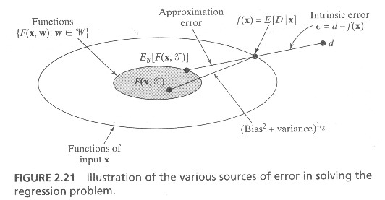
To achieve good overall performance, the bias B(w) and the variance V(w) would both have to be small. Bias/variance Dilemma:
conflict in NN with a training sample of fixed size
Partially Circumvented by purposely introduce bias
, and sometime it is harmless to NN design, using constrained NN structure such as weight-sharing, local receptive field
Notes:
限制 神经网络的结构，会增大 其 bias, 但可能会 减低 variance， 从而 得到更稳健的 网络

Slide 11
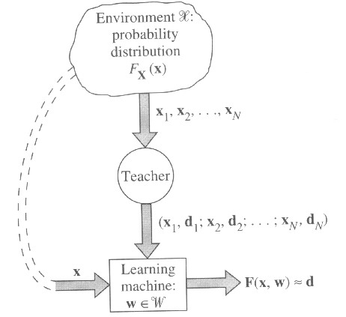
2.14 Statistical learning theory
Supervised learning model — three interrelated components:
environment;
teacher;
learning machine (algorithm).

Slide 12
Assume there are N iid training examples in (2.53)：
The supervised learning problem is that of selecting the particular function F(x,w) that approximates the desired response d in an optimum fashion.
The feasibility of supervised learning depends on:
Do the training examples contain sufficient information to construct a learning machine capable of good generalization performance？——approximation process—find the function F(x,w) that is best possible approximation to the desired function—loss function L(d,F(x,w)).

Slide 13
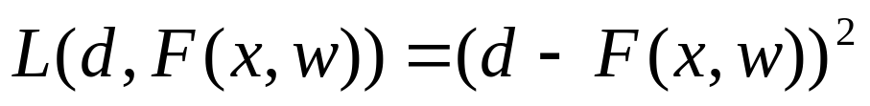
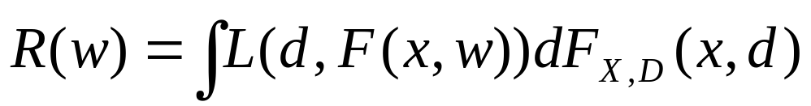
Popular definition: quadratic loss function：
（2.71）
The expected value of the loss is defined by the risk functional R(w)/风险泛函
（2.72）
→Goal of supervised learning: minimize R(w) over class of F(x,w) (various w)
Complicated because the joint cumulative distribution available F_{X,D}(x,d) is usually unknown
the only information available is contained in the training data set J
—> the principle of empirical risk minimization.
Notes:
二次损失函数
风险泛函 求各中近似函数之上的最小
经验风险泛函

Slide 14
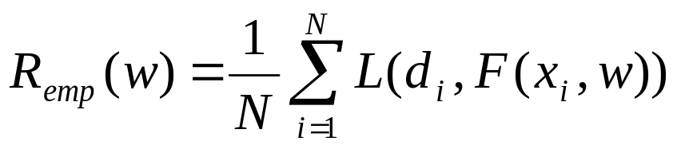
Principle of empirical risk minimization
Basic idea: work with the empirical risk functional：
（2.74）
Differs from risk function R(w) of（2.72）：
  It does not depend on the unknown distribution function F_{X,D}(x,d) in an explicit sense.
  it can be minimized with respect to the weight vector w in theory.
Notes:
实际上是 iid 假设

Slide 15
Equivalent problem：
use minimized empirical risk functional R_{emp}(w) in place of minimized actual risk functional R(w₀) to approximate original risk functional R(w).
Reasonable (law of large numbers)：as N is infinitely large, the empirical mean of the random variable converges to its expected value.
Notes:
approximation：the condition under which the approximate mapping F(x,w_{emp}) is “close” to the desired mapping F(x,w₀).

Slide 16
Approximation：Does a weight w_{emp} minimize R_{emp}(w) will also minimize the orignial R(w)?
What’s the condition under which the approximate mapping F(x,w_{emp}) is “close” to the desired mapping F(x,w₀).
Theory: If R_{emp}(w) approximates R(w) uniformly in w with some precision ε,
then the minimum of R (w_{emp}) deviates from the minimum R(w₀) by an amount not exceeding 2ε。
Notes:
approximation：the condition under which the approximate mapping F(x,w_{emp}) is “close” to the desired mapping F(x,w₀).

Slide 17
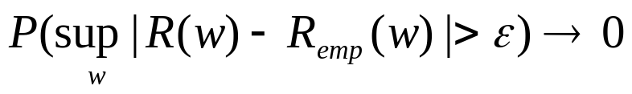
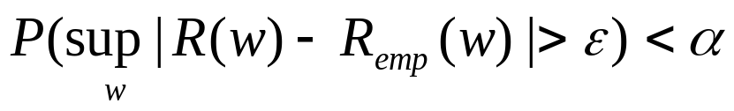
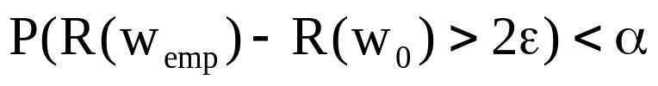
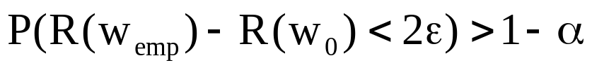
Mathematically : Uniform convergence of the weight w of the R_{emp}(w) to its expected values occur (the weight w₀ of the original risk functional), if：
当N→∞ （2.78）
Equivalently, For someα>0, if we have
（2.79）
Then we have:
（2.80）
With probability at least 1-α, the solution F(x,w_{emp}) that minimizes R_{emp}(w) (i.e. R_{emp}(w_{emp}) ) will give an actual risk R(w_{emp}) that deviates from the true minimum possible actual risk R(w₀) by an amount not exceeding 2ε.
Notes:
Uniformly 一致地
第1段 是结论：
第2 3 段 是相应的数学描述，
最后一段又是结论

Slide 18
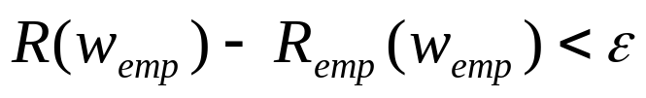
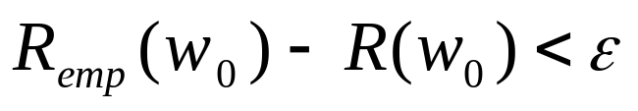
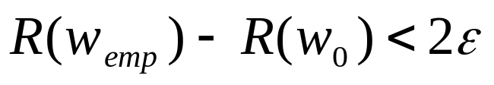
（2.79）
（2.79）implies that with probability 1-α the following two inequalities are satisfied simultaneously：
（2.81）
（2.82）
—— define the differences between the true risk and empirical risk functional at w=w_{emp}（the minimum points of R_{emp}(w)） and w=w₀（ the minimum points of R(w)）, respectively, (2.81)+(2.82) and as we have： R_{emp}(w_{emp})≤R_{emp}(w₀)
finally, we get：
（2.84）
also satisfied with probability 1-α.
Notes:
这里是对 （2。80）的进一步说明
(2.81)中 w(emp)是R(emp)的最小，
（2.82)中 w0是R的最小

Slide 19
Summary
Principle of empirical risk minimization:
  Empirical risk functional R_{emp}(w), in place of the risk functional R(w)
  R (w_{emp}) converges in probability to the minimum of R(w), w∈W, as N is made infinitely large.
  Uniform convergence as defined by（2.78）is a necessary and sufficient condition for the consistency of the principle of empirical risk minimization.
当N→∞ （2.78）

Slide 20
Observation
Prior to the training of a learning machine, all approximating functions are equally likely.
As the training of the learning machine progresses, the likelihood of those approximating functions F(x_{i},w) that are consistent with the training data set is increased.
As the size N of the training data set grows, and the input space is thereby “densely” populated, the minimum point of the R_{emp}(w) converges in probability to the minimum point of R(w).

Slide 21
VC Dimension /page 94
It is a measure of the capacity or expressive power of the family of classification functions realized by the learning machine.
Consider a binary pattern classification problem: the VC dimension of an ensemble of dichotomies F is the cardinality of the largest set L that is shattered by F
（二分总体F 的 VC 维 是被 F 所能分散的最大集合 L 的基数）。
Notes:
cardinality 基
Δ_{F}(N) 表示能由学习机器实现的不同二分的数量，Δ_{F}(l) 增长函数（growth function)
由学习机器能够实现二分的数量。

Slide 22
VC Dimension /page 94
（二分总体F/machine 的 VC 维 是能被 F 所分散的最大集合 L 的基数）。
Let Δ_{F}(L ) denote the number of distinct dichotomies implemented by the learning machine F
We say L is shattered by F if Δ_{F}(L ) =2 ^{|L| ,}
it means all possible dichotomies of L can be induced by functions in F.(集合的所有可能的二分都能由函数F实现)
VC dimension is the largest N such that Δ_{F}(N)=2^{N}.
（基数大小为N=|L| 的集合，其所有可能的二分总数为2^{N}, 如果 一个机器能做到，就说该机器的VC为N)
Notes:
二分总体F/machine 的 VC 维, 注意 这里 是总体F(所有其可能的情况）的 VC， 而不是 一个具体的情况（一个参数具体化后的情况）
cardinality 基
Δ_{F}(l ) denotes case l=|L| ( number of elements of L (the set of N points) ).
L 表示 点集
Δ_{F}(N) 表示能由学习机器实现的不同二分的数量，Δ_{F}(l) 增长函数（growth function)
由学习机器能够实现二分的数量。
对于基数 为N=|L| 的集合，如果 能 有 F/机器 ，满足 公式，即能完全打散 他们，则认为 F的VC dimension 为N

Slide 23
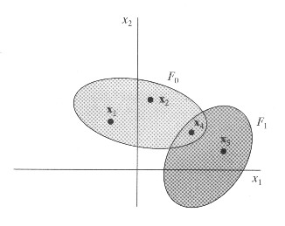


Example 2.1
The function F₀ introduces the dichotomy：
F₁ induces the dichotomy：
With the set J consisting of four points, the cardinality |J|=4. As we have: Δ_{F}(J)=2⁴=16
—> VCdim(F)=4.
16 种情况：
F0 本身 4,J0, J1 交换 又是4， 因此 8
F1 3种， 交换 3 种，
再加 （x1,x2,x3,x4) 和 空 本身 共 两种
Total 16
Notes:
我们能够找到一个函数（machine ) ,把这4点充分 shatter, 也就是实现它所有可能的分散方式，在这里即 2**4 种方式
我们这个机器 （函数）的dim 就是是 4
这里 16 种情况怎么来：
F0 本身 4， J0, J1 交换 又是4， 因此 8
F1 3种， 交换 3 种，
再加 （x1,x2,x3,x4) 和 空 本身 共 两种
Total 16

Slide 24
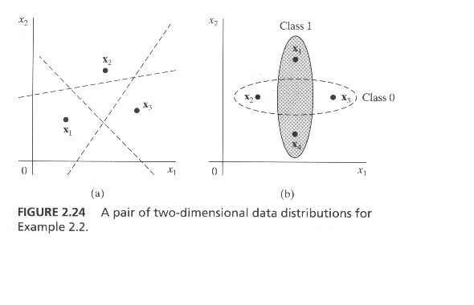
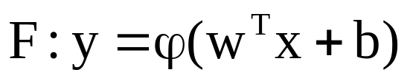
Example 2.2
Consider a simple threshold decision rule:
For the two dimensional input vector x, the linear function can judge 3 points but not 4 points, Vm=3.
Notes:
这个简单的规则(feedforward NN single-layer perceptron)—直线，只能判断 3个点，（左）， 而不能划分 4 个点。

Slide 25
For NN:
The VC dimension of the set of classification function {F(x,w)：w∈W} is the maximum number of training examples that can be learned by the machine without error for all possible binary labelings of the classification functions.
Notes:
training examples 的数量, 如果机器能完全学习这些样本, 也就是能完全区分他们, 也就是能完全 shatter不能它们
The number of examples needed to learn a class of interest reliably is proportional to the VC dimension of that class. ?

Slide 26
In some cases, the VC dimension is determined by the free parameters of a neural network.
However, in most practical cases, it is difficult to evaluate the VC dimension by analytic means → use two special results:

Slide 27
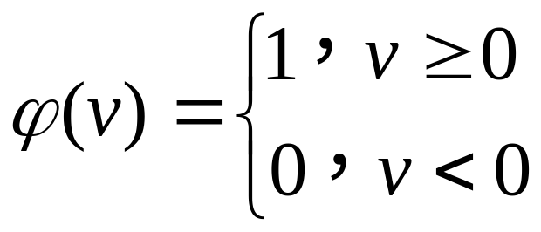
VC Estimation / page 97
→ use two special results:
An arbitrary feedforward network, with a threshold activation function：
The VC dimension is O(WlogW) where W is the total number of free parameters in the network.（Cover(1968), Baum and Haussler(1989)）

Slide 28
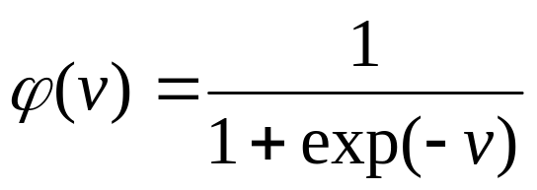
VC estimation
A multilayer feedforward network, whose neurons use a sigmoid activation function:
The VC dimension is O(W²) .
（Koiran and Sontag(1996)）
!! Multilayer feedforward networks have a finite VC dimension.
Notes:
MLP 只有有限的VC Dimension，因此 任何 FNN 其能力不是无限的

Slide 29
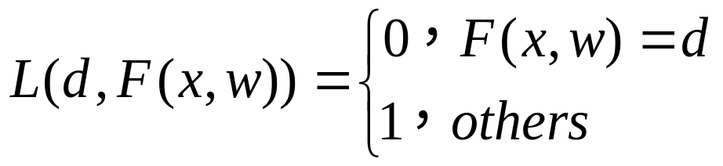
Constructive distribution-free bounds on the generalization ability of learning machines
学习机器---推广能力的--- 构造性自由分布界
In specific case of binary pattern classification (d {0, 1}), the loss function has only two possible values as shown by： (2.90)
Risk functional R(W) and R_{emp}(W) defined in (2.72) /(2.74) assume the following interpretations：
  R(W) is the probability of classification error, i.e. error rate, denoted by P(W).
  R_{emp}(W) is the training error , i.e. frequency of the errors made during the training session, denoted by v(w).
Notes:
Loss function 只有 1 和0两个值, 因为 d=0, 1; F(x,w)=0,1; 因此,L 只有0 和 1 两种情况;
R(W) 是正确的网络的分类错误
R(W) is the probability of classification error, i.e. error rate, denoted by P(W).
Remp(W) 是近似网络在学习阶段的错误，“近似”源于“学习”不足，因此，归结为“训练相关的”错误，

Slide 30
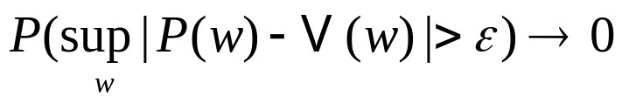
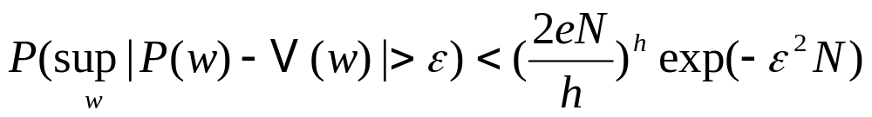
As large size N of training samples
(due to the theory of large numbers)
as N→∞ (2.92)/2.78
In such case, we speak of the uniform convergence of the frequency of training errors to the probability that V(w)=P(w) .
VC dimension—for the set of classification functions with VC dimension h, the following inequality holds：
(2.93)
Notes:
N 训练样本大小
P(w) 是错误的极限（一般不可能没有错误），代表网络本身内含的错误。
v(w) 是训练中的错误，（ 一般应大于P(w)，但在具体情况，有限的样本N时 也可能是小的，见后面 2.100）,随着 N的增大 而接近与 P(w), 这个接近程度 就与 h 和 N 有关。 其中 e 是自然对数的底

Slide 31
(2.93)
Condition for uniform convergence:
the right-hand side of the inequality becomes small for large N, due to the factor exp(-ε²N);
the factor with respect to h should not grow too fast, the right-hand side will go to zero as N goes to infinity.
require the VC dimension h is finite——A finite VC dimension is a necessary and sufficient condition for uniform convergence of the principle of empirical risk minimization.
require the input space has finite cardinality.

Slide 32
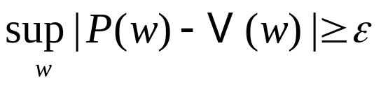


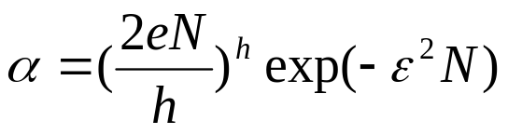
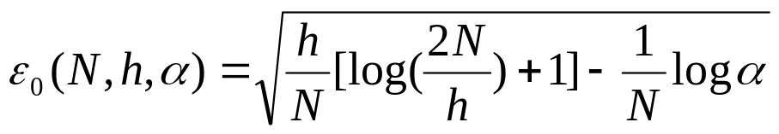
(2.93)
Let α denote the probability of occurrence of the event
Then, with probability 1-α, the following inequality holds：
（2.94）
Using the bound described in (2.93) , we may set
（2.95）
Letε₀(N,h,α) denote the special value of ε that satisfies (2.95). Hence, we readily obtain：
（2.96）
We refer to ε₀(N,h,α) as a confidence interval.
Notes:
置信区间

Slide 33
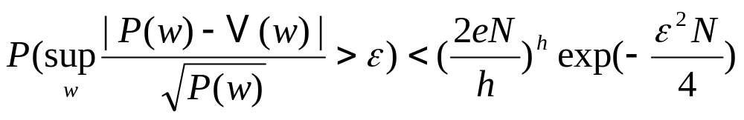

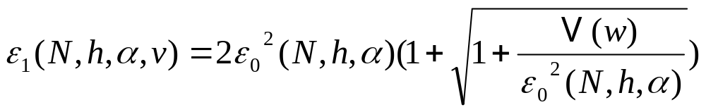

For small P(w), a more useful bound is obtained by modifying (2.93) as follows：
（2.97）
So, with probability 1-α：
（2.98）
Whereε₁ is a new confidence interval：
（2.99）
For v(w)=0, it reduces to the special form (2.99)：
（2.100）
Notes:
从 (2.97) 到 (2.98)\ (2.99) 是作业 2.25的内容,可能在 Vapnik 1992, 1998的book 中有说明
前一页的情况是P(w)比较大也就是界在最坏的情况P(w)=1/2的情况下得到的,对p(w)小的时候不成立, 这里考虑的是P(w)比较小的时候的情况, (2.99)右边 有 v,因此 e1中明确地写出了v.
P(w) 分类误差
V(w) 训练学习误差

Slide 34


summarize：bound for the rate of uniform convergence
1）In general, the bound is(2.98)
2）For a small training error v(w)→0 (2.99)：
3 ）For a large training error v(w)→1(2.99)：

Slide 35
Structural risk minimization
Training error：v_{train}(w) is the frequency of errors made by a learning machine during the training session. (same as v(w))
Generalization error：v_{gene}(w) is defined as the frequency of errors made by machine when it is tested with examples not seen before.
Let h be the VC dimension of a family of classification functions {F(x,w); w∈W} with respect to the input space. In light of the theory on the rate of uniform convergence, with probability 1-α, for N>h, the generalization error v_{gene}(w) is lower than a guaranteed risk v_{guarant}(w).
Guaranteed risk is defined by (2.98)：
Notes:
For N>h， （h 是VC dimension 是该函数簇，或machine 能够学习的最大数）， here N 是训练样本数量（并非种类数）。

Slide 36
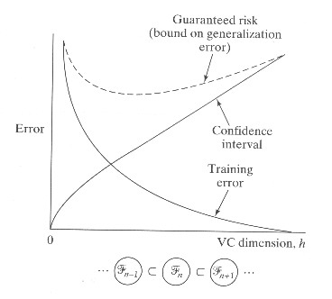
Figure 2-25：Illustration of the relationship between training error, confidence interval, and guaranteed risk.
Supervised learning problem：
realize the best generalization performance by matching the machine capacity to the available amount of training data for the problem at hand.——VC dimension
Notes:
复杂网络 可以降低 training error, 即可以无限拟合输入数据，但会增大 推广中的误差（置信限），因此，不是 网络越复杂越好,而是网络复杂程度(h)与可以拥有的训练样本量相当就行.

Slide 37
Structural risk minimization:
  provides an inductive procedure for achieving this goal by making the VC dimension of the learning machine a control variable.
  Goal: to find a network structure such that decreasing the VC dimension occurs at the expense of the smallest possible increase in training error.
简单性原则：
在不显著增加 训练误差的情况下，减低 VC数（降低NN复杂性)，以减效方差 和这里的 置信限
Notes:
简单性原则：
在不显著增加 训练误差的情况下，减低 VC数（降低NN复杂性)，以减效方差 和这里的 置信限

Slide 38

Specific example:
Define nested structure of n machines/ensemble of n pattern classifiers:
（2.101）
such that we have (individual VC dimension h):
（2.103-104）
Then, the method of structural risk minimization may proceed as follows：
Notes:
变 网络 ，变 VC， 找出 V guarant 最小的

Slide 39
Specific example
The empirical risk, i.e. vtrain(w), for each pattern classifier is minimize
The pattern classifier with the smallest guaranteed risk vguarant(w) is identified. This particular machine provides the best compromise between the training error and the confidence interval, which compete with each other.
Implement：example: vary the VC dimension h by varying the number of hidden neurons.

Slide 40
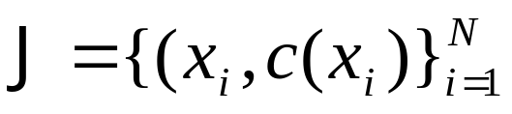
2.15 probably approximately correct model of learning
PAC is a probabilistic framework for the study of learning and generalization in binary classification system and is closely related to supervised learning.
Suppose a target concept c(x) (only takes 0 or 1), as the desired response for the network, is learned by means of a NN on the dataset J defined by：
（2.105）
Let g(x) denote the hypothesis corresponding to the input-output mapping that results from the training.
Notes:
可能近似正确的学习模型

Slide 41

One way of assessing the success of the learning process is to measure how close the hypothesis g(x) is to the target concept c(x).
  ——training error v_{train}：learn a function on the basis of limited information available.
  ——Goal of PAC: to ensure v_{train} is usually small.
（2.106）
H -environment
Two control parameters：
  Error parameter ε∈(0,1] — the error allowed in a approximation of c(x) by the hypothesis g(x)
  Confidence parameter δ∈(0,1] — control the likelihood of constructing a good approximation.
Notes:
error e 就 像是 训练误差
置信限 d 相当于 是 这个“误差”的方差，（ P(w)-v(w) 之间的距离

Slide 42
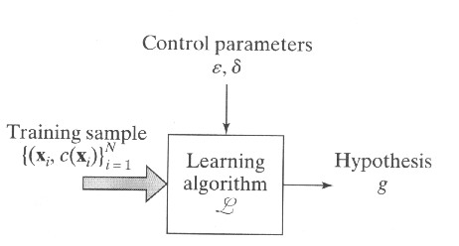
Figure 2.26 Block diagram illustrating the PAC learning model
Notes:
训练误差 e 和它可能存在的方差 d

Slide 43
PAC in formally state
Let C be a concept class over the environment H. The concept class C is said to be PAC learnable if there exists an algorithm L with the following property:
For every target concept c∈C,
for every probability distribution on H ,
and for all 0<ε<1/2 and 0<δ<1/2,
If the learning algorithm L is supplied with
the set of training examples,
and the parameters ε and δ ,
Then with probability at least 1-δ,
the learning algorithm L outputs a hypothesis g with error v_{train}≤ε.
Notes:
here the target concept 就 象 是

Slide 44
PAC in formally state
This probability is taken over the random examples drawn from the dataset J and any interval randomization that may exist in the learning algorithm L.
The sample size N must be greater than a function of ε and δ .
Notes:
L 的内在随机性

Slide 45
Sample complexity
Focus:
how many random examples should be presented to the learning algorithm for it to acquire sufficient information to learn an unknown target concept c chosen from the concept class C,
Or, how large should be the size N of the training set J be?
Closely linked with the VC dimension.
Notes:
Consistent concept
相容概念，相容学习算法

Slide 46
Consistent concept
concept c is said to be consistent with the training set J ( or equivalently, J is consistent with c), if for all 1≤i≤N we have c(x_{i})=d_{i.}
_{( kearns and Vazarini, 1994)}

Slide 47
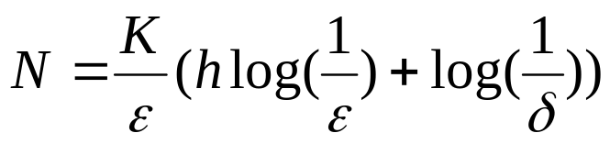
Two key results:
1. Any consistent learning algorithm for that NN with finite VC dimension h ≥1 is a PAC learning algorithm
2. There is a constant K such that a sufficient size of training set J for any such algorithm is:
(2.107)
Notes:
考虑具有有限VC 维的NN,任何用于这个NN的相容学习算法 都是一个PAC算法

Slide 48
Impressively -1:
It is applicable to a supervised learning process regardless of the type of learning algorithm used, and the underlying probability distribution for generating the labeled examples.
-- broad generality
Notes:
比较理论结果与实际结果可见有很大的偏差， 原因是 这个不一致性 反映了 理论测度是在分布无关、最坏的情况下的结果，因此，在平均意义上，我们可以做得更好

Slide 49
Impressively -1:
Comparison of results predicted from bounds on measures based on the VC dimension with experimental results reveals a wide numerical discrepancy:
The discrepancy is merely a reflection of the distribution-free, worse-case nature of the theoretical measures,
-- on average we can always do better.
Notes:
比较理论结果与实际结果可见有很大的偏差， 原因是 这个不一致性 反映了 理论测度是在分布无关、最坏的情况下的结果，因此，在平均意义上，我们可以做得更好

Slide 50
Computational complexity
Computational complexity deals with the worst-case “running time” needed to train a NN (learning machine), given a set of examples of some finite size N.
  Not depend on the speed of hardware
  Usually measured in terms of the number of operations ( addition, multiplication and storage) needed to perform the computation.

Slide 51
Example size m:
Assess the computational complexity of a learning algorithm: how it varies with the example size m, i.e. size of the input layer of the NN being trained.
For the algorithm to be computationally efficient, the running time should be O(m ^{r}) for some fixed integer r≥1. ——Running time is increase polynomially with m.
——Learning tasks performed by a polynomial time algorithm are usually regarded as “easy”.

Slide 52
Error parameter ε:
as ε is decreased, the learning task under study would become more difficult.
——For efficient computation, the appropriate condition is to have the running time polynomial in 1/ε.

Slide 53
summary
A learning algorithm is computational efficient with respect to error parameter ε, example size m and size N of the training set
if its running time is polynomial in N and if there is a value of N₀( δ,ε) sufficient for PAC learning is polynomial in both m and ε.
Notes:
A learning algorithm is computational efficient with respect to error parameter ε, example size m, and size N of the training set if its sunning time is in N and if there is a value of N₀( δ,ε) sufficient for PAC learning is polynomial in both m and ε.

